Slide 1


DEPARTMENT OF COMPUTER SCIENCE AND ENGINEERING
Bapuji Institute of Engineering and Technology, Davangere-577004
Technical Seminar Presentation
“Voice Recognition Based IoT Home Automation System”
Guide Name:
Dr. Abdul Razak M S _{Ph.D}
Head of the Department:
Dr. Nirmala C R _{Ph.D}
Presented By:
Jeevan H K (4BD20CS040)

Slide 2
CONTENTS OF TABLE
1
Introduction
5
Advantages
2
Literature Review
6
Applications
3
Methodology
7
Conclusion & References
4
Implementation

Slide 3


Slide 4

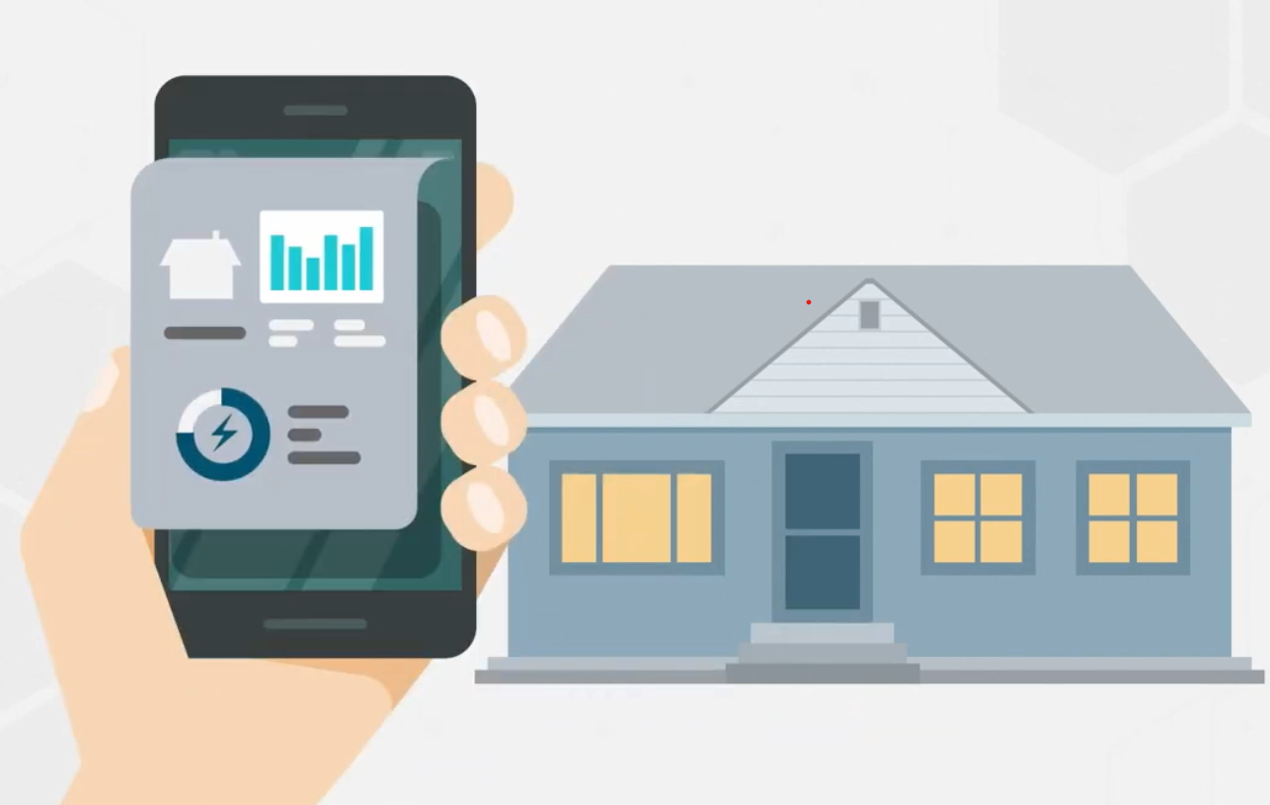
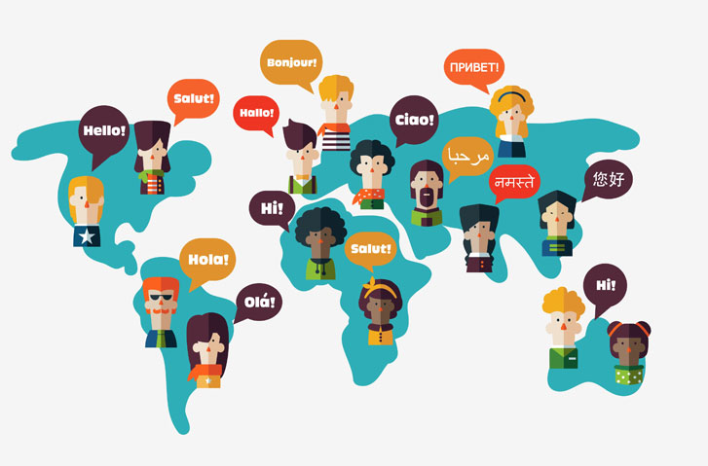
INTRODUCTION
Limited language support.
Elderly People/
Accessibility for users with disabilities.
Reliance on Mobile phone/GUI.
4

Slide 5
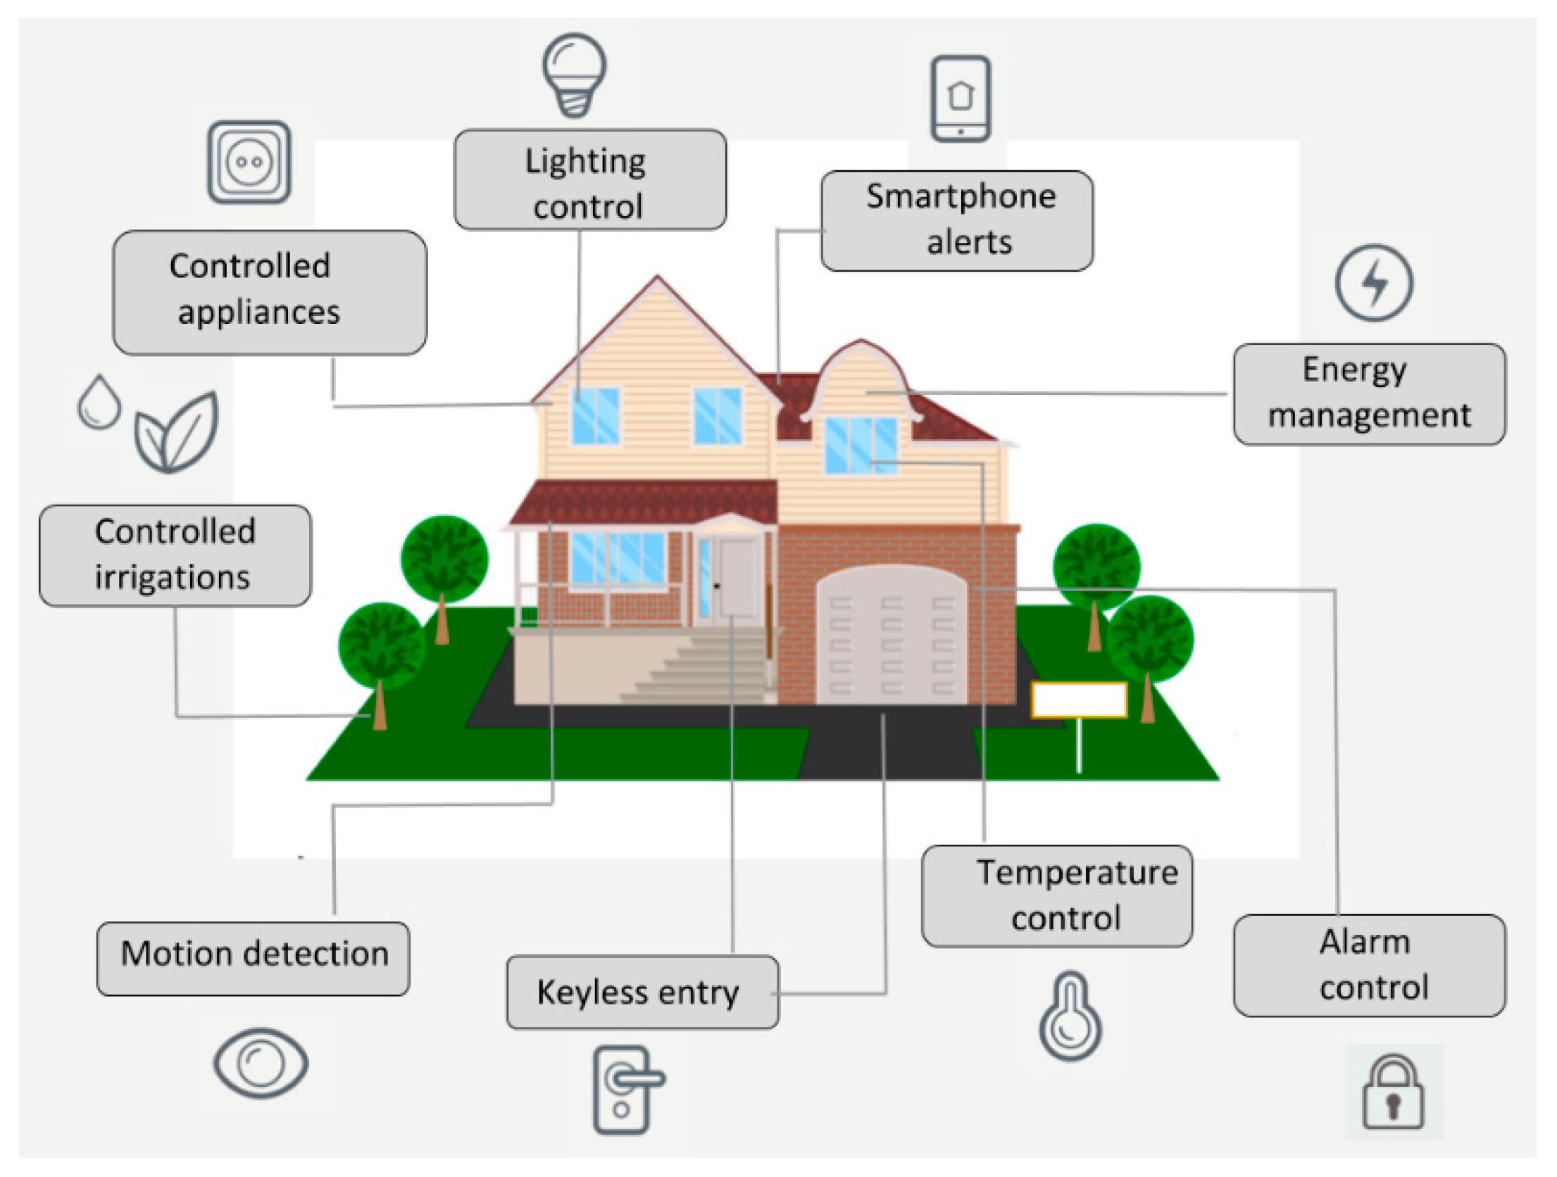
INTRODUCTION
Leveraging edge computing and optimized speech recognition algorithms.
System operates without internet connectivity.
Evaluating the system's performance in terms of response time, accuracy, and energy consumption.
integration of natural language processing in healthcare and home automation
Integration of digital technologies.
Elderly population with less technological skills.
Voice recognition systems emerge as a promising solution.
Implementing Voice Recognition System relay on constant internet connectivity.

Slide 6

HELLO!
LITRATURE SURVEY
Title of the paper | Authors and Year | Methodology | Remarks
Redefining home automation through voice recognition system | S. F. N. Zaidi, V. K. Shukla, V. P. Mishra, and B. Singh Year: 2021 | Emerging Technologies in Data Mining and Information Security (Advances in Intelligent Systems and Computing) | Fail to explore the real-world applications and use cases of Voice Recognisation.
Edge intelligence: Paving the last mile of artificial intelligence with edge computing | Z. Zhou, X. Chen, E. Li, L. Zeng, K. Luo, and J. Zhang. Year: Aug. 2019 | Review, case studies, data collection, analysis, comparison, and recommendations, offers a promising avenue for deploying artificial intelligence at the edge | Edge intelligence is the need for careful consideration of security and privacy concerns, along with challenges related to hardware limitations and network connectivity issues in edge environments.
I AM JAYDEN SMITH
I am here because I love to give presentations.
You can find me at @username

Slide 7
HELLO!
LITRATURE SURVEY
Title of the paper | Authors and Year | Methodology | Remarks
Multichannel automatic recognition of voice command in a multi-room smart home: An experiment involving seniors and users with visual impairment | M. Vacher, B. Lecouteux, and F. Portet Year: Sep. 2014 | The methodology likely involves conducting experiments in a multi-room smart home environment, where voice commands are captured and recognized using multichannel automatic recognition techniques. | The remark could highlight the significance of the study in addressing accessibility and usability challenges faced by seniors.
Use of intelligent voice assistants by older adults with low technology use | A. Pradhan, A. Lazar, and L. Findlater Year: Aug. 2020 | The methodology likely involved conducting user studies or surveys to assess the adoption, usability, and preferences of intelligent voice assistants among older adults with limited technology use. | Implications of the study findings for designing and improving intelligent voice assistant systems to better meet the needs and preferences of older adults with limited technology use.
I AM JAYDEN SMITH
I am here because I love to give presentations.
You can find me at @username

Slide 8
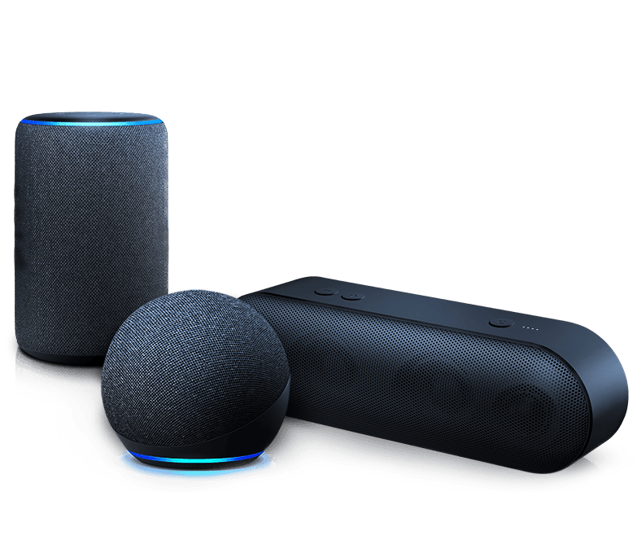
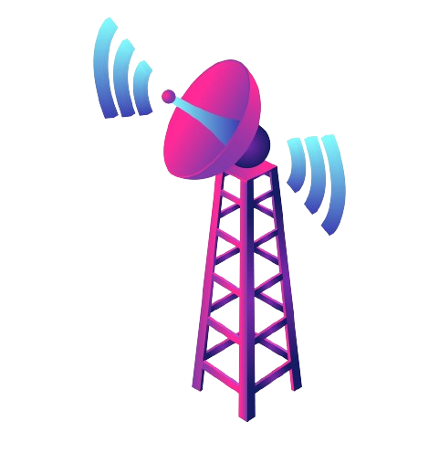



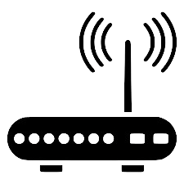
METHODOLOGY
Frameworks are used to process commands
Voice Input
Voice Assistant Device
Transmission
Interconnected by Bluetooth Mesh
Receiver/Sensors
Micro Controller
Appliances

Slide 9
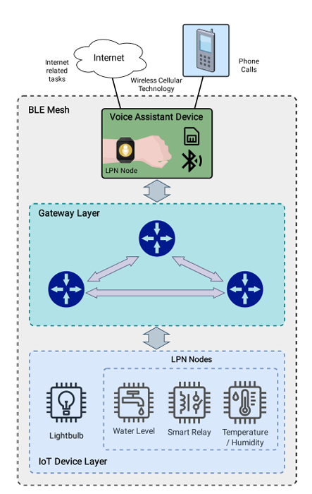
ARCHITECTURE
Operates autonomously on edge devices.
User portability.
Voice-controlled interaction.
Provides distance between the devices within the building/premises
Designed to run on batteries (LPN)
Interaction of the nodes in the gateway and IoT device layers.
Main Architecture

Slide 10
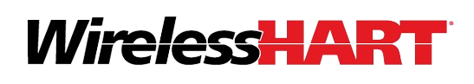





IMPLEMENTATION
COMMUNICATIONS TECHNOLOGY SELECTION
BLUETOOTH 5
Operating frequency.
Maximum range.
Maximum data rate.
Encryption.
Topology.
Latency.
Battery lifetime.
Cost

Slide 11
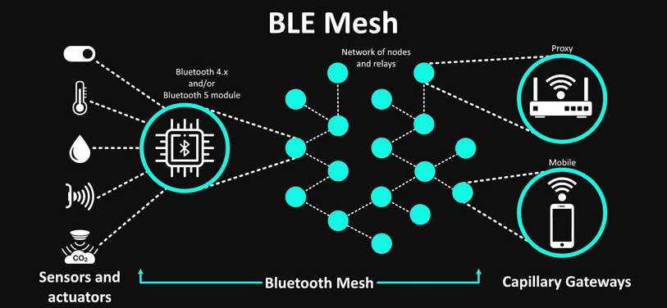
IMPLEMENTATION
COMMUNICATIONS TECHNOLOGY SELECTION
Architecture of the Bluetooth Mesh

Slide 12

IMPLEMENTATION
SPEECH-RECOGNITION FRAMEWORK SELECTION
HuBERT
Wav2Vec2
Whisper
Self-supervised speech recognition model
Pre-training large-scale speech representation framework
Developed by Facebook AI Research, Google.
Maintain stable performance even under varying conditions

Slide 13



ADVANTAGES
Benefits to elderly individuals: Improved accessibility, independence, safety, convenience, and social connectivity, ultimately enhancing their overall well-being and quality of life.
Offline Voice Commands : Voice commands can be processed locally without internet connectivity
Edge Operation: The system operates exclusively at the edge without the need for an internet connection.
Minimal Infrastructure Deployment: It does not rely on complex cloud-based solutions.
Fast and Efficient Response Times :Ensures timely interaction and control of IoT devices, enhancing user experience and convenience
Privacy Protection : Users can have greater confidence in the security and privacy of their personal information.

Slide 14






APPLICATIONS
Elderly Care Facilities
Home Healthcare
Accessible Smart Homes
Community Centers and Senior Centers
Rural and Remote Communities
Smart Cities
Public Spaces
Hospitality Industry
Retail Environment
Smart Offices
Hospitality Industry

Slide 15
CONCLUSION
The IoT home automation system operates solely at the edge, eliminating the need for an internet connection.
The system demonstrates efficient performance in both static and mobile opportunistic scenarios.
A distributed architecture is implemented without expensive gateways or hubs, simplifying communication with IoT nodes.
Evaluation of an opportunistic approach reveals favorable latency and response times across various scenarios.
Performance metrics such as latency, accuracy, and energy consumption are detailed for the tested models.
Transmission latency between the Voice Activity Detection (VAD) and IoT nodes is within acceptable limits even in worst-case scenarios.
Overall, the system addresses challenges in IoT home automation with voice assistance and offers promising performance in diverse environments and language contexts.

Slide 16
THANK YOU!

